Slide 1
Blacktown Chinese Christian Church
Welcome to Our English Service 19.01.2025
English Service 9:45 – 11:00 am
Worship Songs: Passage: Speaker: Topic: Response Song: Announcements and Closing Prayer Benediction
Be Thou My Vision 10000 Reasons Man Of Sorrows In Christ Alone Mathew 16:13-17 Heb 1:1-4 TBA TBA TBA

Slide 2
BCCC english service

Slide 3

Please keep all phones on silent

Slide 4
Be Thou My Vision
Eleanor Henrietta Hull, Mary Elizabeth Byrne © Words: Public Domain Music: Public Domain CCLI Licence No. 5485849 . CCLI Song number: 30639

Slide 5
Verse 1
Be Thou my Vision, O Lord of my heart
Naught be all else to me, save that Thou art
Thou my best Thought, by day or by night
Waking or sleeping, Thy presence my light

Slide 6
Verse 2
Be Thou my Wisdom, and Thou my true Word
I ever with Thee and Thou with me, Lord
Thou my great Father, I Thy true son
Thou in me dwelling, and I with Thee one

Slide 7
Verse 3
Riches I heed not, nor man's empty praise
Thou mine Inheritance, now and always
Thou and Thou only, put first in my heart
High King of Heaven, my Treasure Thou art

Slide 8
Verse 4
High King of Heaven, my victory won
May I reach Heaven's joys, bright Heaven's Sun!
Heart of my own heart, whatever befall
Still be my Vision, O Ruler of all

Slide 9
Outro
Heart of my own heart, whatever befall
Still be my Vision, O Ruler of all

Slide 10
10000 Reasons (Bless The Lord)
Jonas Myrin, Matt Redman © 2012 2011 Atlas Mountain Songs (Admin. by SHOUT! Music Publishing Australia) CCLI Licence No. 5485849 . CCLI Song number: 6016351

Slide 11
Chorus
Bless the Lord oh my soul
Oh my soul
Worship His Holy name

Slide 12
Chorus
Sing like never before
Oh my soul
I'll worship Your Holy name

Slide 13
Verse 1
The sun comes up
It's a new day dawning
It's time to sing Your song again

Slide 14
Verse 1
Whatever may pass
And whatever lies before me
Let me be singing
When the evening comes

Slide 15
Chorus
Bless the Lord oh my soul
Oh my soul
Worship His Holy name

Slide 16
Chorus
Sing like never before
Oh my soul
I'll worship Your Holy name

Slide 17
Verse 2
You're rich in love
And You're slow to anger
Your name is great
And Your heart is kind

Slide 18
Verse 2
For all Your goodness
I will keep on singing
Ten thousand reasons
For my heart to find

Slide 19
Chorus
Bless the Lord oh my soul
Oh my soul
Worship His Holy name

Slide 20
Chorus
Sing like never before
Oh my soul
I'll worship Your Holy name

Slide 21
Verse 3
And on that day
When my strength is failing
The end draws near
And my time has come

Slide 22
Verse 3
Still my soul will
Sing Your praise unending

Slide 23
Verse 3
Ten thousand years
And then forevermore
Forevermore

Slide 24
Chorus
Bless the Lord oh my soul
Oh my soul
Worship His Holy name

Slide 25
Chorus
Sing like never before
Oh my soul
I’ll worship your holy name

Slide 26
Chorus
Bless the Lord oh my soul
Oh my soul
Worship His Holy name

Slide 27
Chorus
Sing like never before
Oh my soul
I’ll worship your holy name

Slide 28
Tag
Lord I’ll worship your holy name
I’ll worship your holy name

Slide 29
Outro
Sing like never before
Oh my soul
I'll worship Your Holy name
I'll worship Your Holy name

Slide 30
Man Of Sorrows
Brooke Ligertwood, Matt Crocker © 2012 Hillsong Music Publishing Australia CCLI Licence No. 5485849 . CCLI Song number: 6476063

Slide 31
Verse 1
Man of Sorrows, Lamb of God
By His own betrayed
The sin of men and wrath of God
Has been on Jesus laid

Slide 32
Verse 2
Silent as He stood accused
Beaten, mocked, and scorned
Bowing to the Father's will
He took a crown of thorns

Slide 33
Chorus
Oh that rugged cross, my salvation
Where Your love poured out over me
Now my soul cries out "Hallelujah!"
Praise and honour unto Thee

Slide 34
Verse 3
Sent of heaven, God's own Son
To purchase and redeem
And reconcile the very ones
Who nailed Him to that tree

Slide 35
Chorus
Oh that rugged cross, my salvation
Where Your love poured out over me
Now my soul cries out "Hallelujah!"
Praise and honour unto Thee

Slide 36
Bridge
Now my debt is paid, it is paid in full
By the precious blood that my Jesus spilled
Now the curse of sin has no hold on me
Whom the Son sets free, oh is free indeed! (x2)

Slide 37
Chorus
Oh that rugged cross, my salvation
Where Your love poured out over me
Now my soul cries out "Hallelujah!"
Praise and honour unto Thee

Slide 38
Verse 4
See, the stone is rolled away
Behold the empty tomb
Hallelujah, God be praised
He's risen from the grave!

Slide 39
Chorus
Oh that rugged cross, my salvation
Where Your love poured out over me
Now my soul cries out "Hallelujah!"
Praise and honour unto Thee

Slide 40
Outro
Praise and honour unto Thee

Slide 41

Bible reading

Slide 42
Matthew 16:13-17
¹³ When Jesus came to the region of Caesarea Philippi, he asked his disciples, “Who do people say the Son of Man is?”
¹⁴ They replied, “Some say John the Baptist; others say Elijah; and still others, Jeremiah or one of the prophets.”

Slide 43
Matthew 16:13-17
¹⁵ “But what about you?” he asked. “Who do you say I am?”
¹⁶ Simon Peter answered, “You are the Messiah, the Son of the living God.”

Slide 44
Matthew 16:13-17
¹⁷ Jesus replied, “Blessed are you, Simon son of Jonah, for this was not revealed to you by flesh and blood, but by my Father in heaven.

Slide 45
Hebrews 1:1-4
In the past God spoke to our ancestors through the prophets at many times and in various ways, ² but in these last days he has spoken to us by his Son, whom he appointed heir of all things, and through whom also he made the universe.

Slide 46
Hebrews 1:1-4
³ The Son is the radiance of God’s glory and the exact representation of his being, sustaining all things by his powerful word. After he had provided purification for sins, he sat down at the right hand of the Majesty in heaven. ⁴ So he became as much superior to the angels as the name he has inherited is superior to theirs.

Slide 47
In Christ Alone
Keith Getty, Stuart Townend ©2001 Thankyou Music (Admin. by SHOUT! Music Publishing Australia) CCLI Licence No. 5485849. CCLI Song number: 3350395

Slide 48
Verse 1
In Christ alone my hope is found
He is my light, my strength, my song
This Cornerstone, this solid Ground
Firm through the fiercest drought and storm

Slide 49
Verse 1
What heights of love, what depths of peace
When fears are stilled, when strivings cease
My comforter, my All in All
Here in the love of Christ I stand

Slide 50
Verse 2
There in the ground His body lay
Light of the world by darkness slain
Then bursting forth in glorious day
Up from the grave He rose again

Slide 51
Verse 2
And as He stands in victory
Sin’s curse has lost its grip on me
For I am His and He is mine
Bought with the precious blood of Christ

Slide 52
Verse 3
No guilt in life, no fear in death
This is the power of Christ in me
From life’s first cry to final breath
Jesus commands my destiny

Slide 53
Verse 3
No power of hell, no scheme of man
Can ever pluck me from His hand
Til He returns or calls me home
Here in the power of Christ I’ll stand

Slide 54
Outro
Till He returns or calls me home
Here in the power of Christ I’ll stand
Here in the power of Christ we stand

Slide 55
Announcements

Slide 56





Account name: Blacktown Chinese Christian Church
Account number: 4216 50263
Offering
BSB: 112 - 879
Please put in "offering" as the reference
The offering box is available at the back of the hall

Slide 57
Prayer points

Slide 58
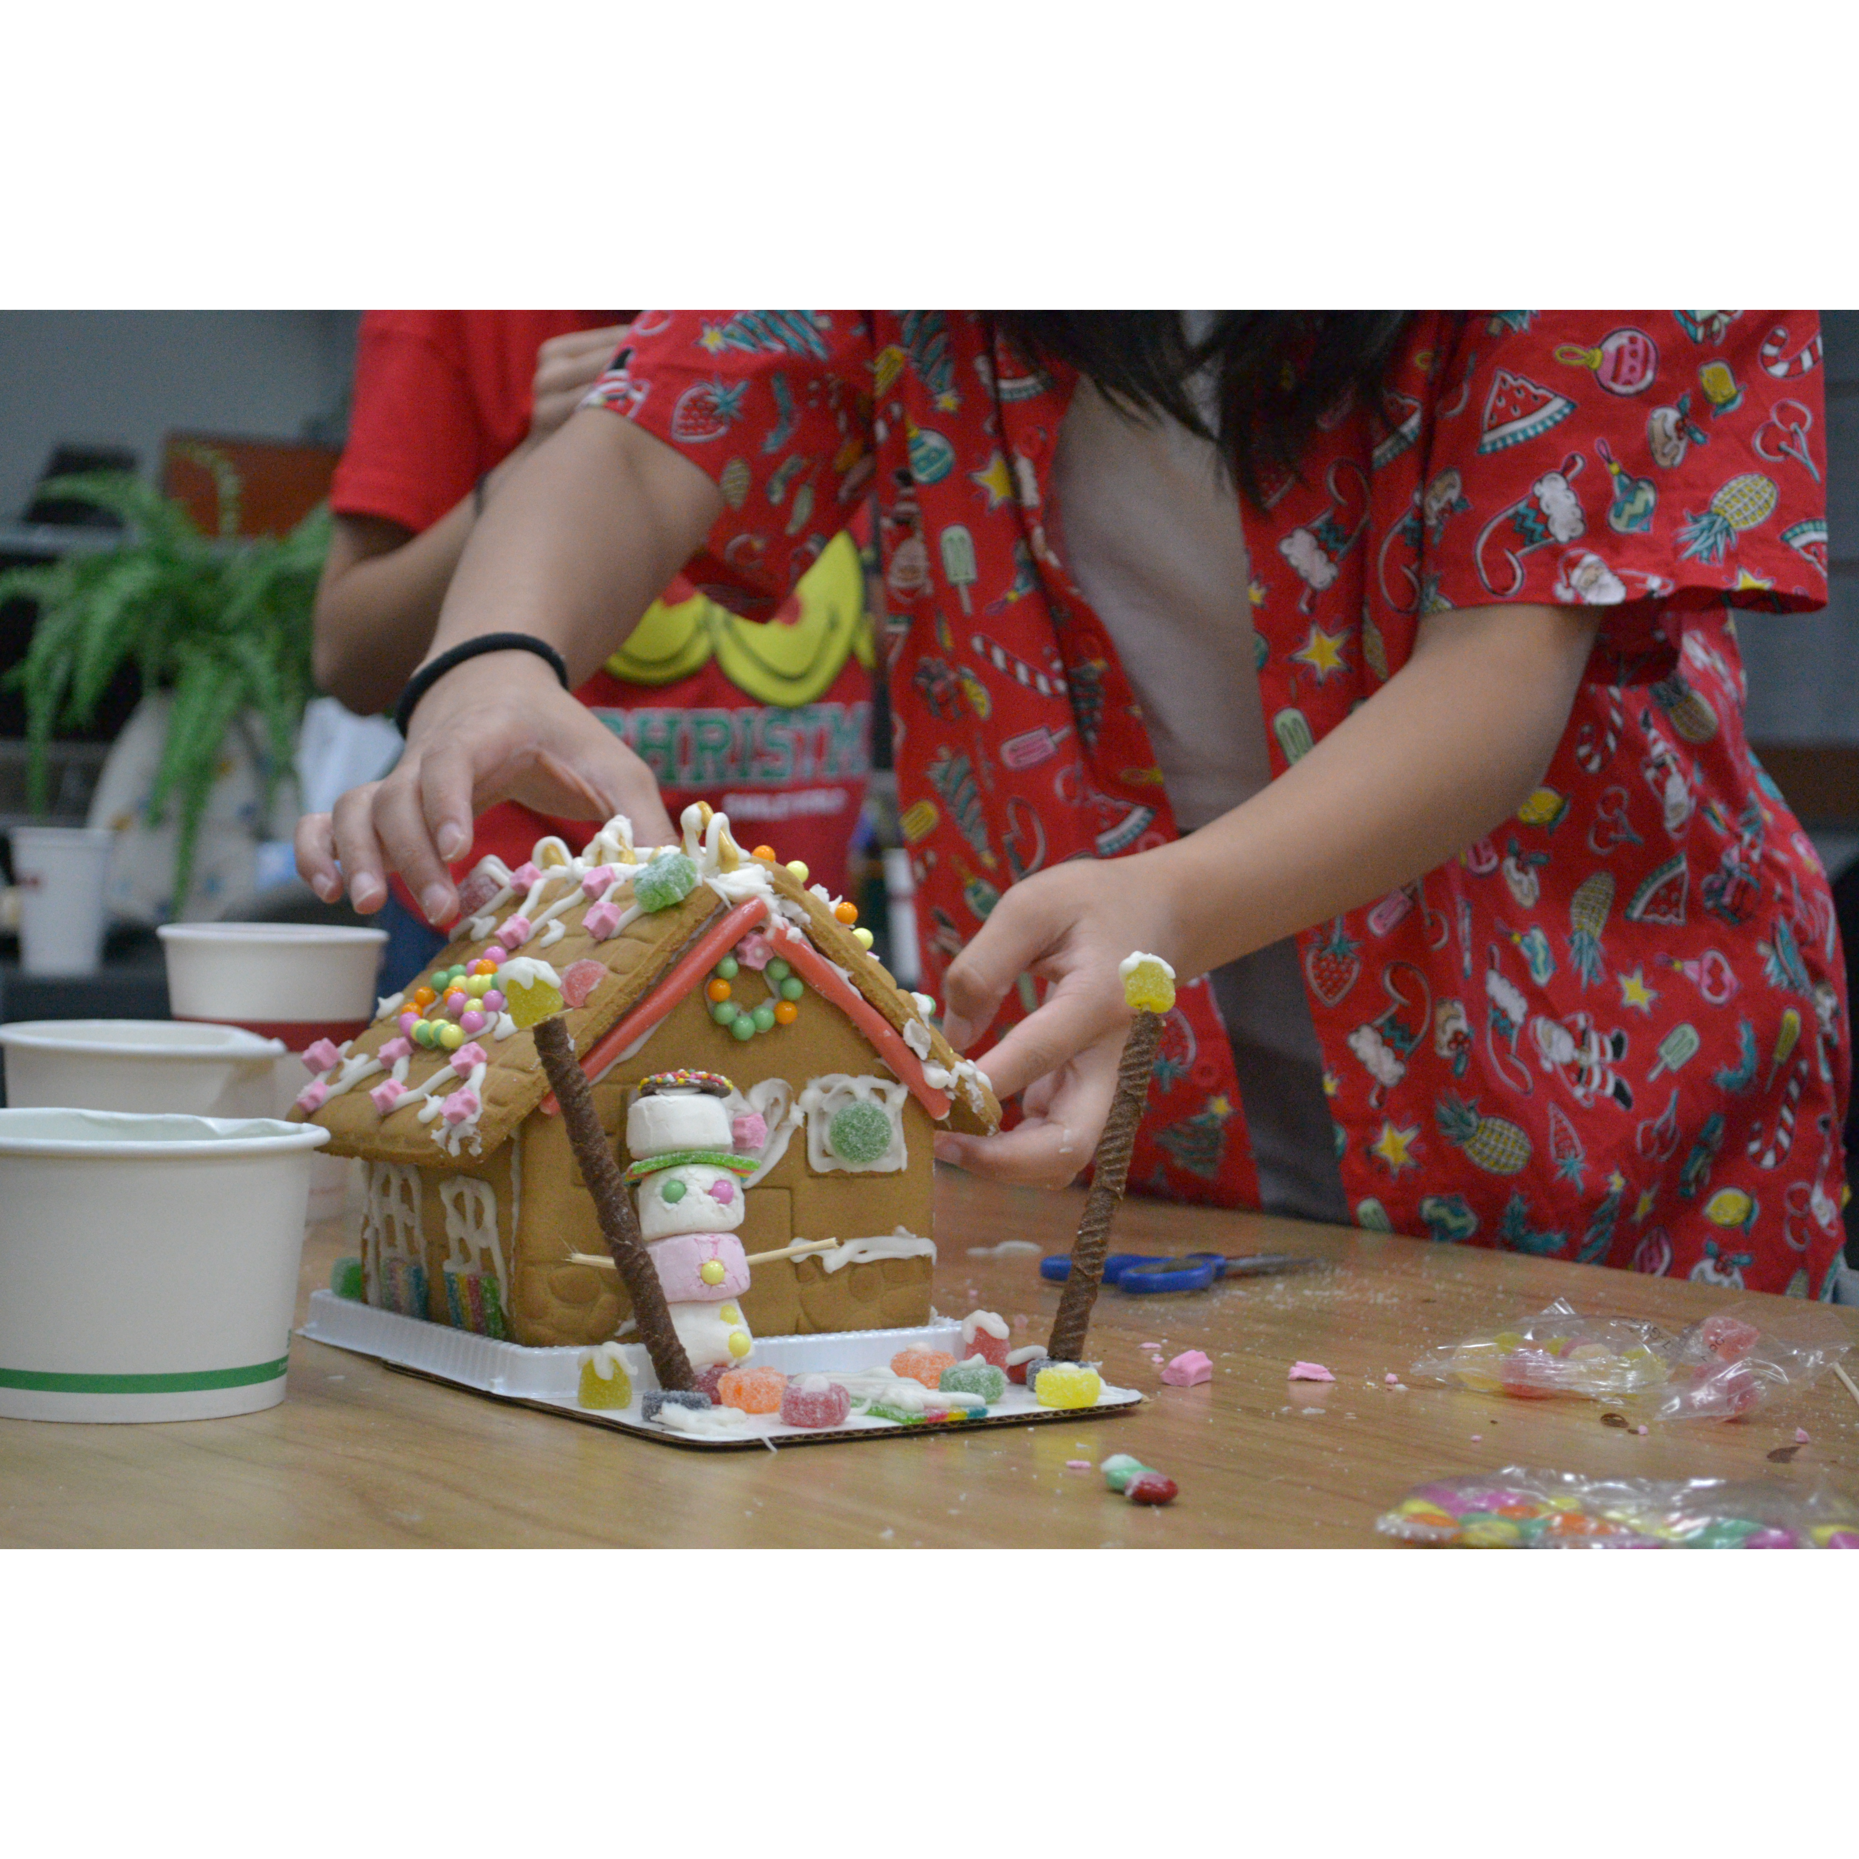
Mingle time!

